Slide 1
IMPROVING SLEEP QUALITY MONITORING WITH IOT AND MACHINE LEARNING

Slide 2
Current sleep monitoring systems are invasive or expensive, limiting widespread use and accessibility. there is a significant need for accessible and precise monitoring of sleep quality. Current solutions often fail to comprehensively capture critical sleep-related data such as body movement, heart rate, blood oxygen levels, and snoring patterns in real-time. Furthermore, existing systems may not seamlessly integrate various sensors with advanced data analysis platforms or might be prohibitively expensive, complex, and not user-friendly.
Problem
Statement

Slide 3
Solution
The proposed solution involves integrating an accelerometer, pulse oximeter, and microphone with an ESP32 microcontroller, leveraging Wi-Fi and Bluetooth for real-time data transmission to the AWS cloud. Machine learning algorithms, including a random forest model and recurrent neural network, analyze the data for comprehensive sleep quality assessment. The system ensures affordability, user-friendliness, and precise monitoring of body movement, heart rate, blood oxygen levels, and snoring patterns. By combining the Internet of Things (IoT) and machine learning, the innovative sleep monitoring system offers an accessible and accurate alternative, fostering improved sleep quality assessment in both home and hospital environments.

Slide 4




Tech Stack
Software
Hardware

Slide 5
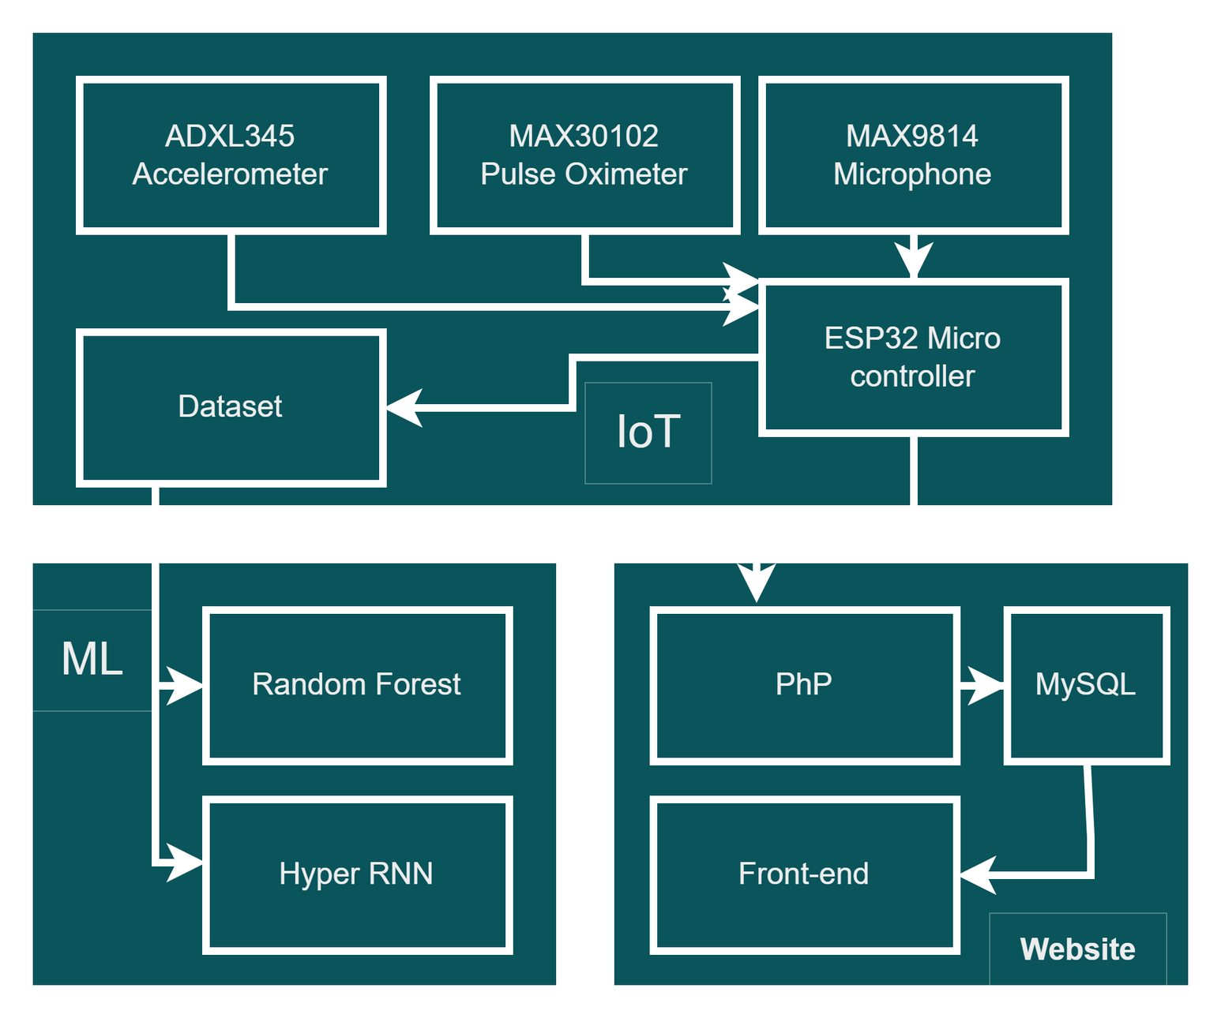
Working
Principle
Modules:
IoT
ML
Website

Slide 6
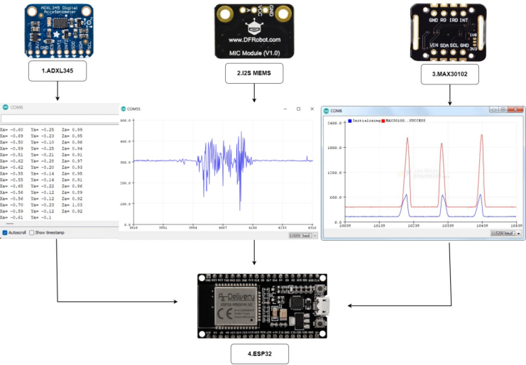
Hardware
Architecture
Sensors:
ADXL345-Accelerometer
12S MEMS - Mic
MAX30102 - Pulse Oxi
Micro
Controller:
ESP32

Slide 7
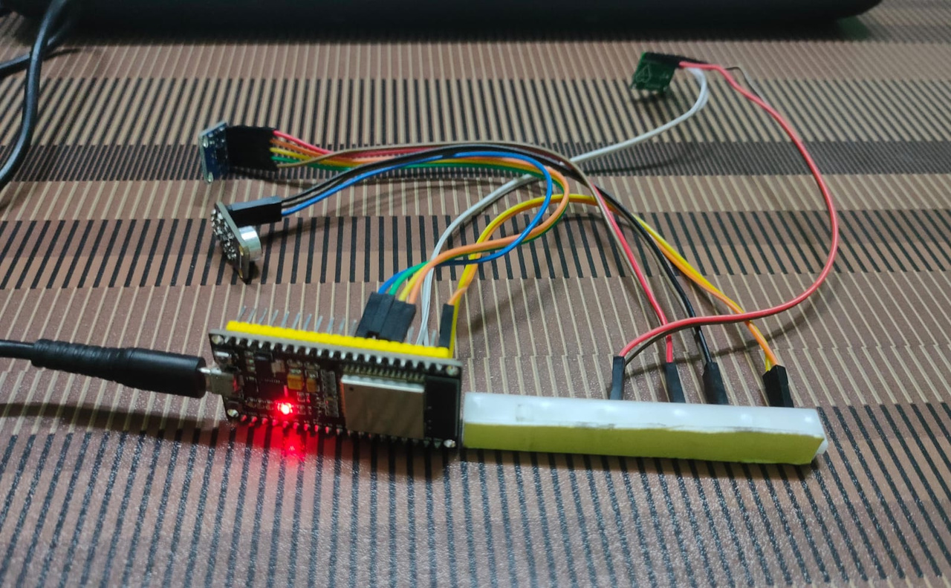
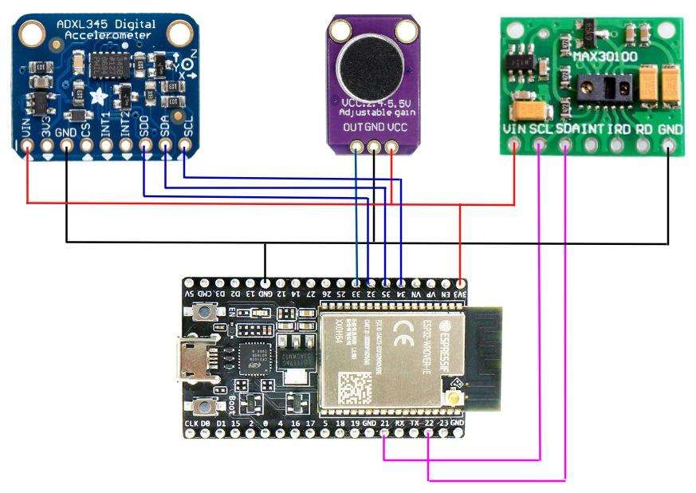
Circuit Diagram

Slide 8
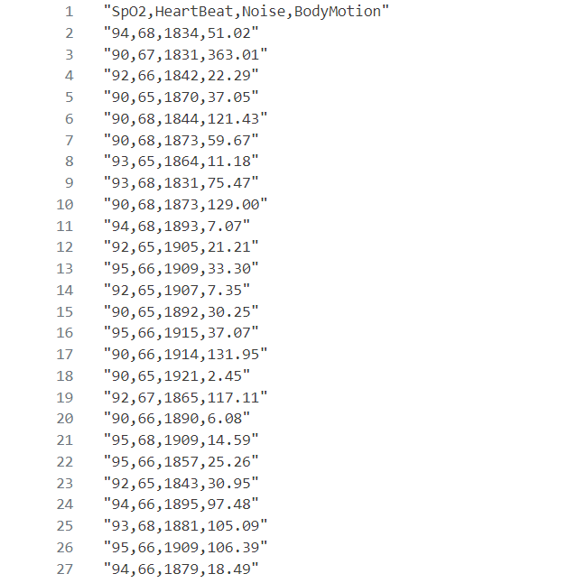
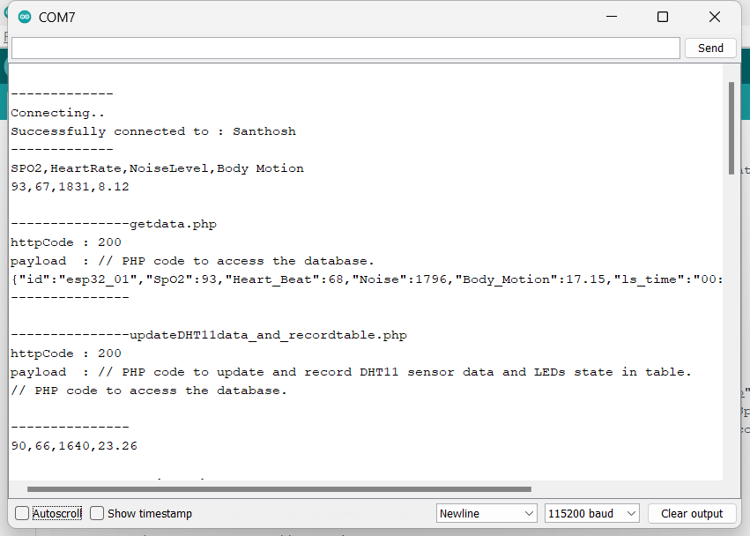
Dataset/COM :

Slide 9
Parameters
Parameters/Algorithm | Random Forest | Hyper RNN
Estimators | 50 | 40
Time Steps | 5 | 4
RMSE | 0.017 | 0.064
Variance | 0.170 | 0.168
MSE | 0.0002 | 0.004
F1 Score | 0.999 | 0.996

Slide 10
RNN / RF
The Random Forest graph illustrates an accuracy plateau at 86%, while the RNN graph displays a superior 95.7% accuracy.
RNN demonstrates superior performance in processing sequential physiological data for nuanced sleep pattern analysis.

Slide 11
Optimal Values
Heat Beat | 65 - 67
Noise | 1700 - 1900
Body Movement | 150 - 250
SpO2 % | 90 - 96

Slide 12
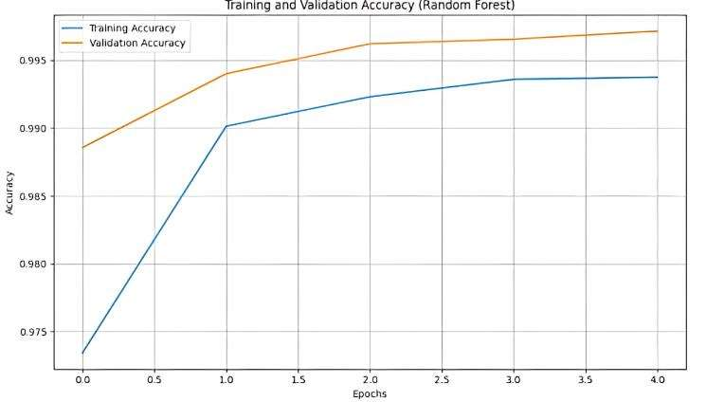
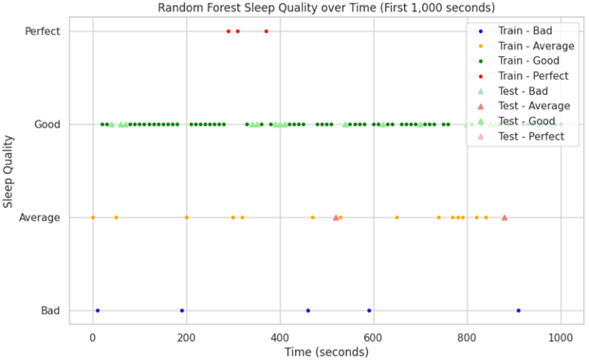
Random Forest
Result and analysis

Slide 13
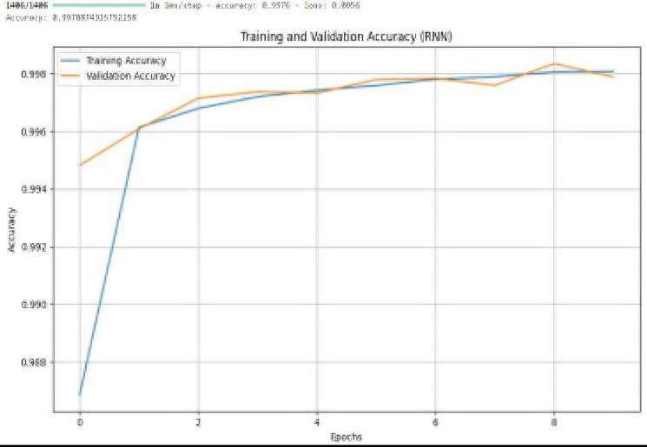
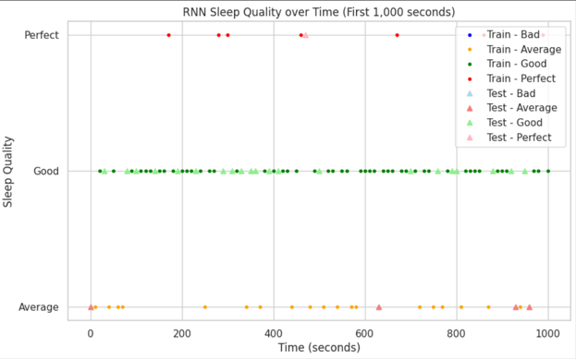
Hyper RNN

Slide 14
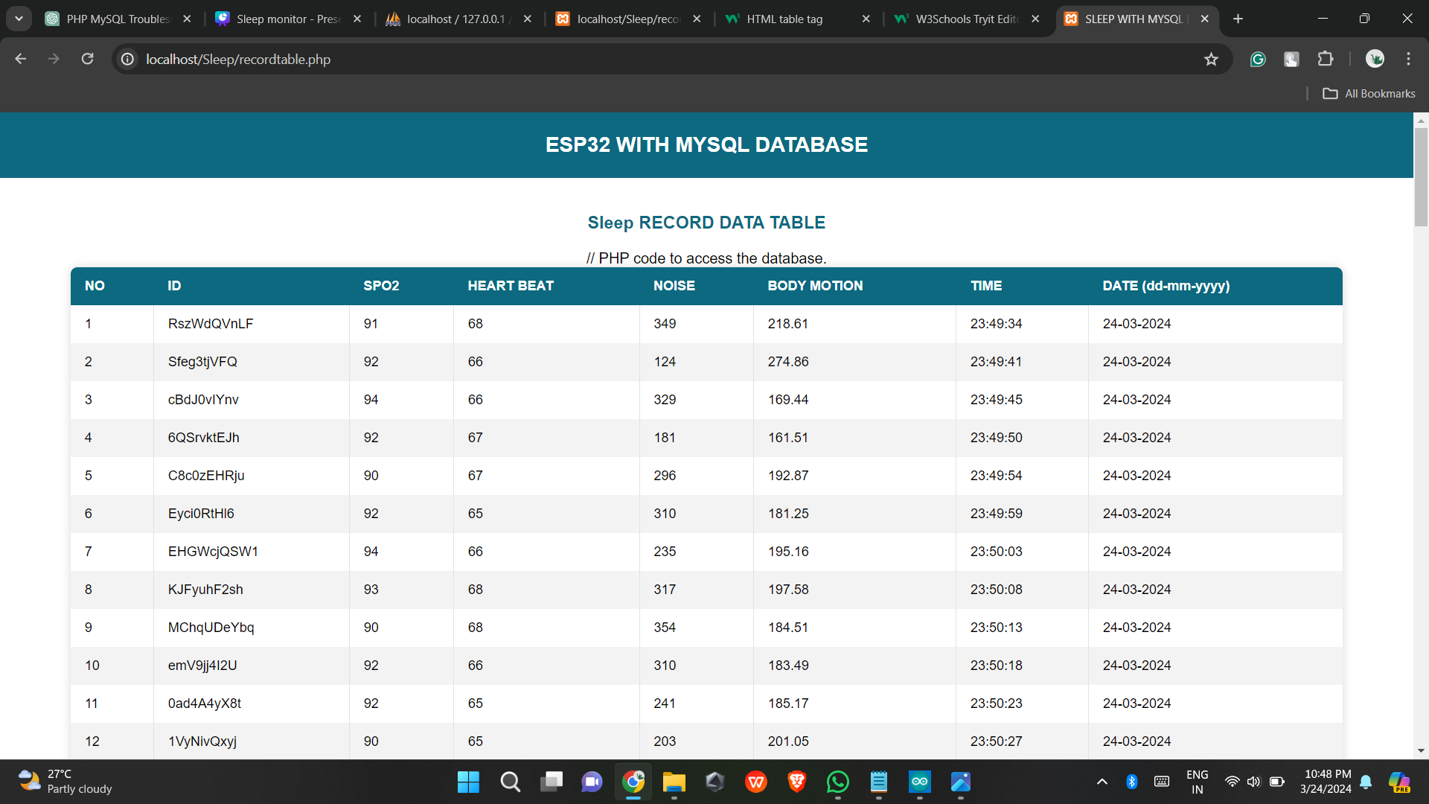
Website
Dynamically updates real-time sleep data.
View all the insights of our sleep-personalized recommendations to improve their sleep pattern.

Slide 15
Future
Enhancement
Sensor Upgrades and Integration
Algorithm Refinement and Optimization
Expansion of Monitoring Parameters
Integration with Wearable Devices
Low-latency wireless transfer
Dynamic Insight graphs of sleep

Slide 16
Author | Topic | Content | Advantage | Disadvantage
W. H. M. Saad, C. W. Khoo, S. I. Ab Rahman, M. M. Ibrahim, and N. H. M. Saad | Development of sleep monitoring system for observing the effect of the room ambient toward the quality of sleep, | Development of a sleep monitoring system. Study on room ambient's impact on sleep quality. | Provides insight into room ambient effects on sleep quality. Offers a potential solution for personalized sleep monitoring. | Limited scope on other factors impacting sleep. Requires further validation for broader applicability.
S. Coussens, M. Baumert, M. Kohler et al. | Movement distribution: new measure of sleep fragmentation in children with upper airway obstruction | Introduces "movement distribution" as a novel measure of sleep fragmentation and provides insights into sleep patterns of children with upper airway obstruction. | Introduces "movement distribution" as a novel measure of sleep fragmentation | Limited to children with upper airway obstruction, may not generalize to other populations.
E. K. Choe, S. Consolvo, N. F. Watson, and J. A. Kientz | Opportunities for computing technologies to support healthy sleep behaviors | Presents opportunities for integrating technology into sleep health interventions. | Explores computing technologies' potential in promoting healthy sleep behaviors. | Focuses on potential rather than empirical evidence of effectiveness.
Back to Agenda Page

Slide 17
Author | Topic | Content | Advantage | Disadvantage
H. Sattar, I. S. Bajwa, and U. Shafi, “An IoT-based intelligent wound monitoring system | An IoT-based intelligent wound monitoring system, | An IoT-based intelligent wound monitoring system developed by H. Sattar, I. S. Bajwa, and U. Shafi. | Enables remote and real-time monitoring of wounds, enhancing patient care. | Requires reliable internet connectivity and potential security risks associated with IoT devices.
M. Kay, E. K. Choe, J. Shepherd et al | Lullaby: a capture & access system for understanding the sleep environment | Research by M. Kay, E. K. Choe, J. Shepherd, and colleagues. | Addresses the impact of technology on human behavior and social interactions. | May oversimplify complex sociotechnical issues and lack interdisciplinary perspectives.
B. Sarwar, I. S. Bajwa, N. Jamil, S. Ramzan, and N. Sarwar | An intelligent fire warning application using IoT and an Adaptive neuro-fuzzy inference system | Paper authored by B. Sarwar, I. S. Bajwa, N. Jamil, S. Ramzan, and N. Sarwar. | Presents collaborative research potentially covering diverse perspectives. | complexity, computational demands, potential real-time performance issues, increased processing burden.
Back to Agenda Page

Slide 18
Author | Topic | Content | Advantage | Disadvantage
T. Hao, G. Xing, and G. Zhou, | iSleep: unobtrusive sleep quality monitoring using smartphones, | ubiSleep, ubiquitous, sensor system, sleep monitoring, network, comprehensive. | Innovative approach utilizing smartphones for sleep quality monitoring. | Privacy concerns and potential inaccuracies in smartphone-based sleep monitoring.
Khizra Saleem, Imran Sarwar Bajwa , 1 Nadeem Sarwar, Waheed Anwar, and Amna Ashraf | Healthcare: Design of Smart and Cost-Effective Sleep Quality Monitoring System | "Real-time ball detection and tracking with embedded systems for sports analysis and robotics." | Smart and cost-effective IoT system for monitoring sleep quality in healthcare. | Potential challenges in ensuring accuracy and data security in IoT-based healthcare monitoring.
A. H. Sodhro, A. S. Malokani, G. H. Sodhro, M. Muzammal, and L. Zongwei | An adaptive QoS computation for medical data processing in intelligent healthcare applications | advanced algorithms, accurate tracking, trajectory prediction, sports analysis, robotics applications. | Adaptive Quality of Service (QoS) computation enhances efficiency of medical data processing in intelligent healthcare applications. | Potential complexity and implementation challenges in adapting QoS for varied healthcare data types.
Back to Agenda Page

Slide 19
Author | Topic | Content | Advantage | Disadvantage
A. Alkhayyat, A. A. Thabit, F. A. Al-Mayali, and Q. H. Abbasi | WBSN in IoT health-based application: toward delay and energy consumption minimization | ubiSleep, ubiquitous, sensor system, sleep monitoring, network, comprehensive. | Focus on minimizing delay and energy consumption in Wireless Body Sensor Networks (WBSN) for IoT health applications. | Potential trade-offs between minimizing delay, energy consumption, and maintaining data accuracy in WBSN for healthcare.
Khizra Saleem, Imran Sarwar Bajwa , 1 Nadeem Sarwar, Waheed Anwar, and Amna Ashraf | Healthcare: Design of Smart and Cost-Effective Sleep Quality Monitoring System | "Real-time ball detection and tracking with embedded systems for sports analysis and robotics." | Exploration of inter-WBAN cooperation to reduce outage probability in IoT health systems using energy harvesting. | Complexity and coordination challenges may arise in implementing inter-WBAN cooperation for energy efficiency.
A. A. Thabit, M. S. Mahmoud, A. Alkhayyat, and Q. H. Abbasi | “Energy harvesting Internet of Things health-based paradigm: towards outage probability reduction through inter –wireless body area network cooperation | advanced algorithms, accurate tracking, trajectory prediction, sports analysis, robotics applications. | Focus on improving energy efficiency through body-to-body cooperation in the Internet of Medical Things (IoMT). | Challenges in implementing and managing body-to-body cooperation in IoMT, including privacy and synchronization issues.
Back to Agenda Page

Slide 20
Paper Publication
The paper is completed and communicated.

Slide 21
Santhoshraj Y
santyraj25@gmail.com
Thank you
Varun N
varunnaresh06@gmail.com

